Slide 1

WP4 Progress UNIFI
Meeting 09/01/2024
Daniele Fiaschi
Associate Professor
SERG Group

Slide 2
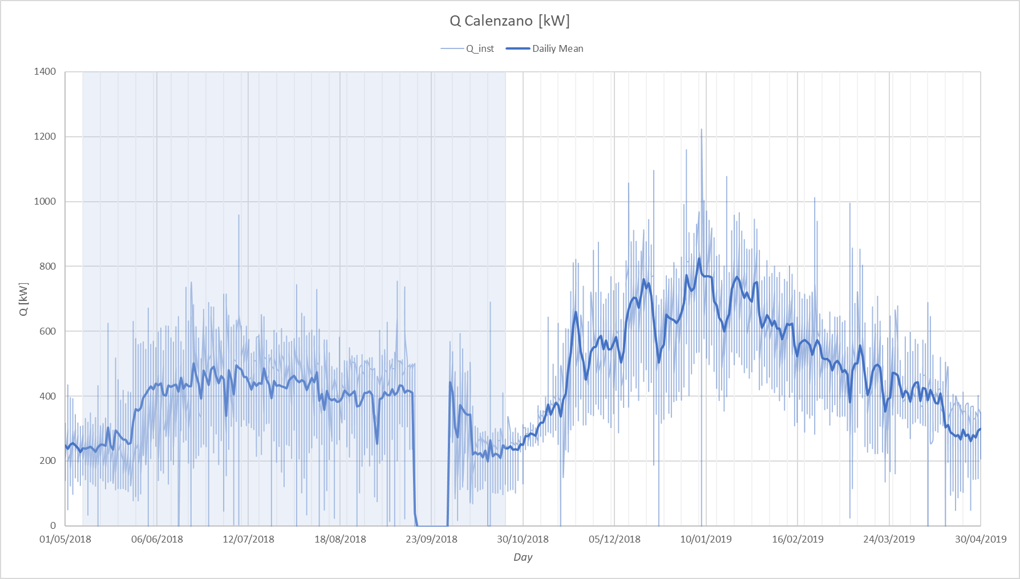
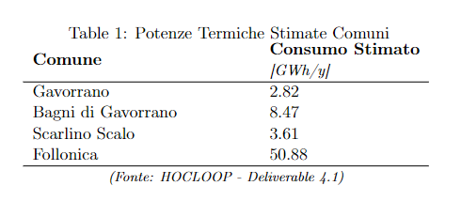
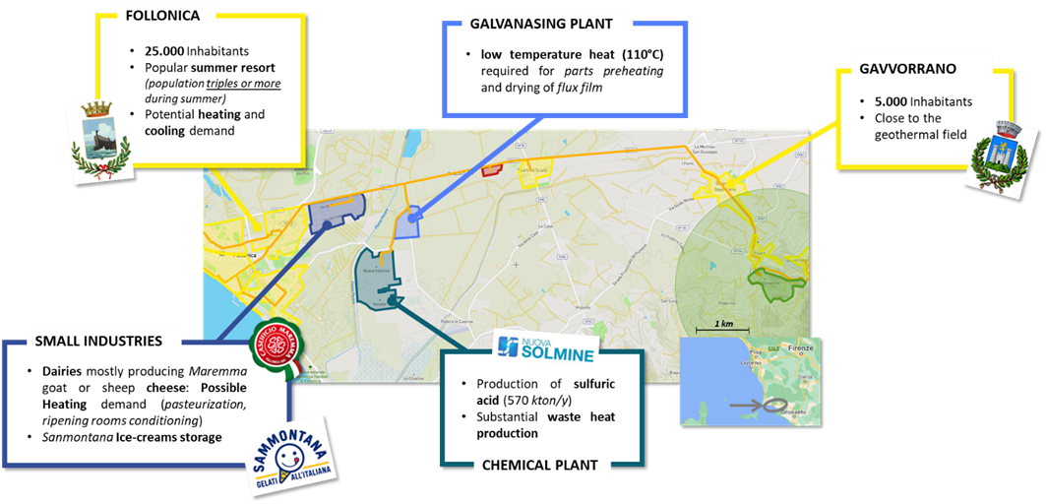
1
Load Forecasting
2) Rescaled to match the predicted consumption in the area
1) Data from the Calenzano DH network

Slide 3
2
Surface Installation Modelling
Heat Pump
Power Production

